Slide 1
Upload
Technical - Overview
Integration Team
February 2018

Slide 2
AGENDA
Industry directories
RMA Upload
EBA Upload
SWIFT REF
TARGET 2 Upload
SSI Upload
EISCD Upload
GPI Upload
SOA static data (profiles handling)

Slide 3
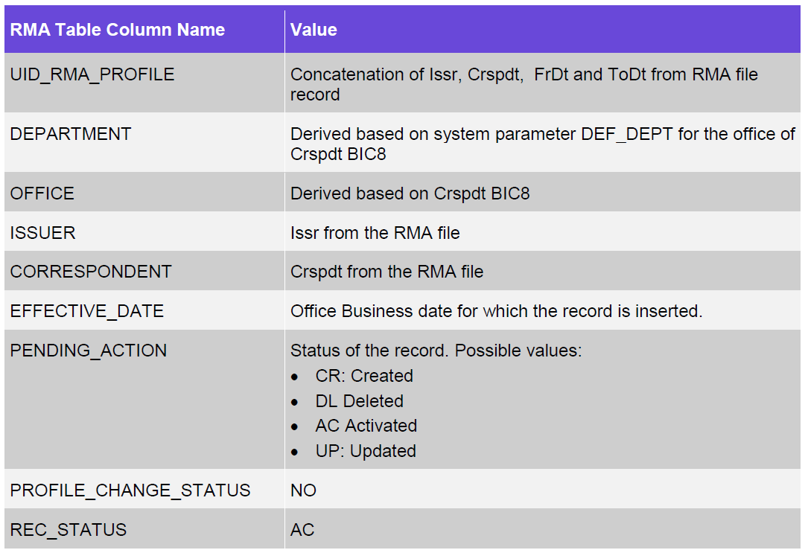
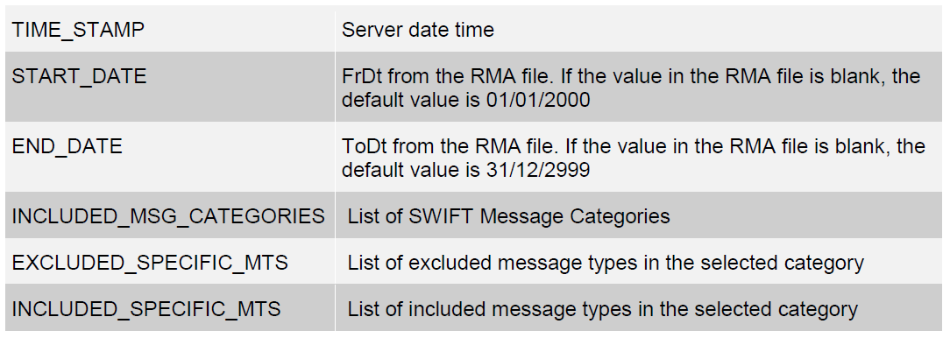
RMA upload - Overview
RMA is received and uploaded using the RMA XML file
RMA validation checks the relationship between counterparties

Slide 4

RMA upload - Processing
Create new RMA records - when the status is enabled and there is a new relationship between the issuer and correspondent
Modify RMA records - with status Enabled that holds a changed relationship between issuer and correspondent can be updated
Delete RMA records - with status Rejected, Revoked or Deleted that holds a changed relationship between issuer and correspondent can be deleted
Validations for file header and record during upload. MOP, MT, routing during processing

Slide 5
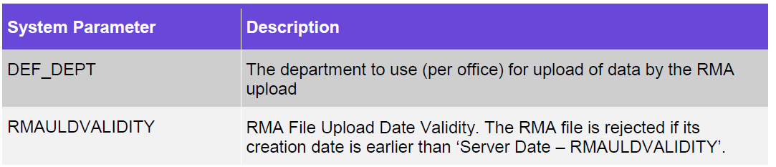
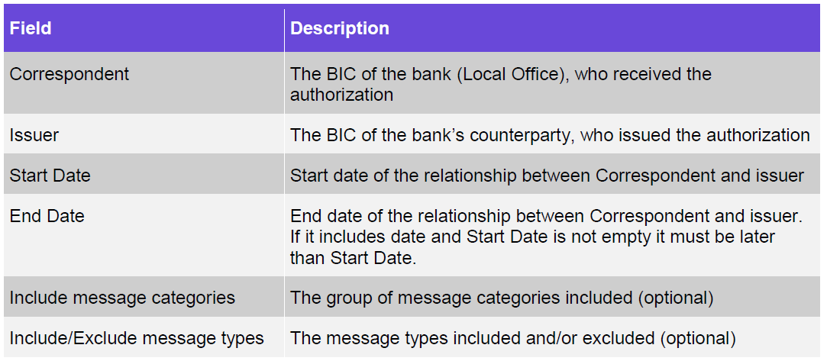
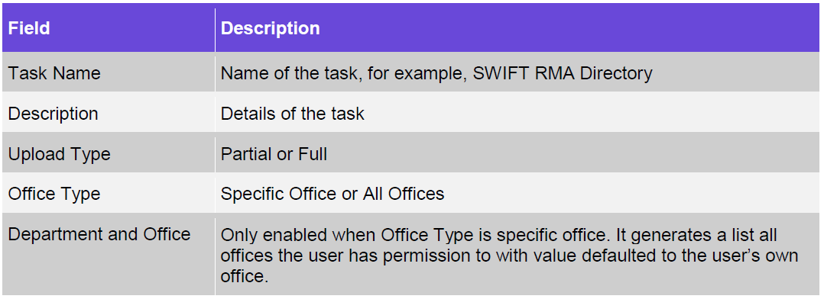
RMA upload – Business Setup
System parameters
SWIFT RMA Profile
Task

Slide 6
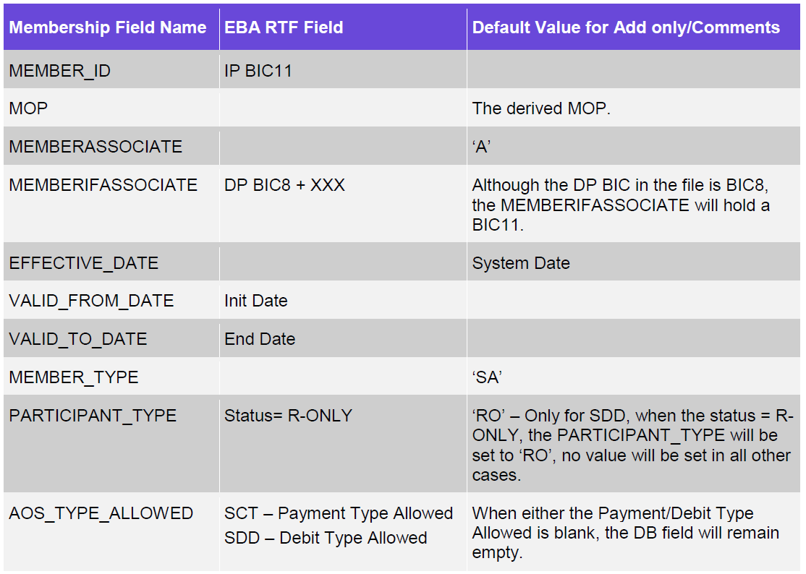
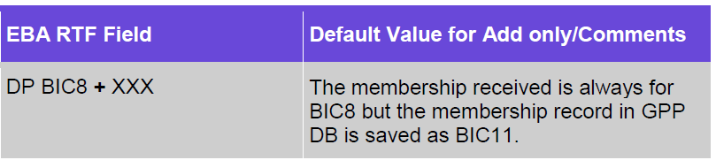
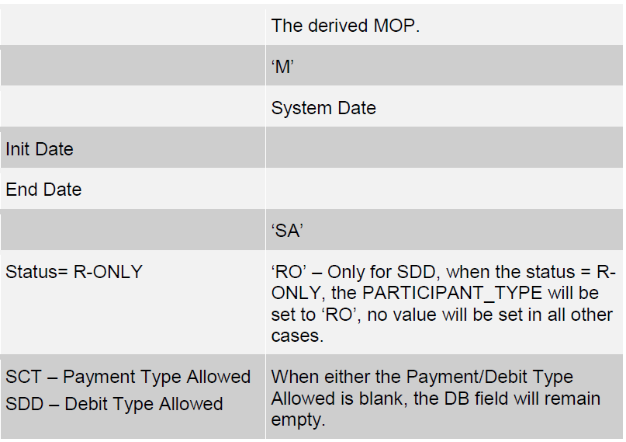
EBA upload - Processing
The EBA Upload provides the identification of Financial Institutions as participants in SEPA Credit Transfer and/or SEPA Direct Debit (Core and B2B) Schemes and hold the routing relationship between DP (Direct Participant) and IP (Indirect Participant) in those schemes.
Indirect Participants
Direct Participants

Slide 7
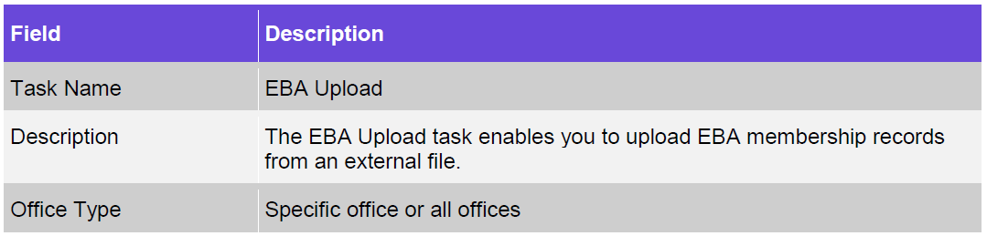
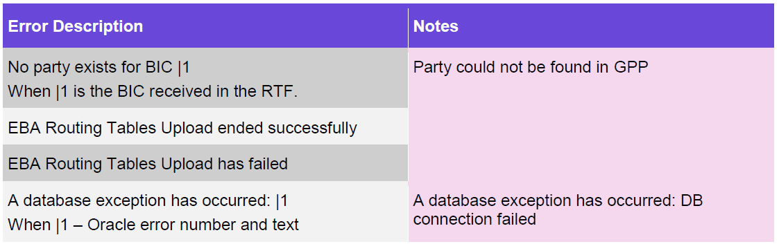
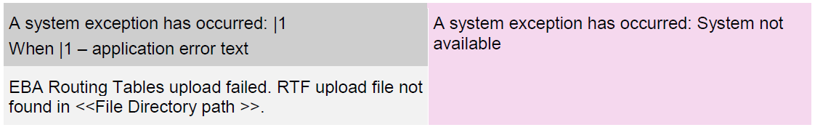
EBA upload– Business Setup
Task
Errors

Slide 8
SWIFT ref, SEPAPLUS, IBANPlus
Bank Directory Plus - contains rich information on all financial institutions including all BIC codes, national bank codes of more than 140 countries (BICPlusIBAN directory contained 72 countries), institutions’ hierarchies (HQ, national branches, foreign branches) and other data that is unique
The SEPAROUTING file contains data that is needed to send SEPA payments to the right SEPA-ready destination using SEPA-ready channels.
The IBAN Plus contains bank’s IBAN-related details such as name, national bank codes embedded in IBANs and BICs used with IBANs. IBAN Plus contains data for all 32 SEPA countries and the related territories, and most of the non-SEPA countries that have adopted IBAN.
Entries actions
U (unchanged) - ignored
M (modified) – update record if not found treat as A
A (added) insert new if duplicated treat as M
D (deleted) apply soft or hard depending on record date
Updated profiles:
CUSTOMERS
CURRENCY_CFG
MEMBERSHIP

Slide 9
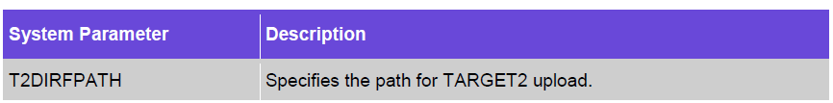
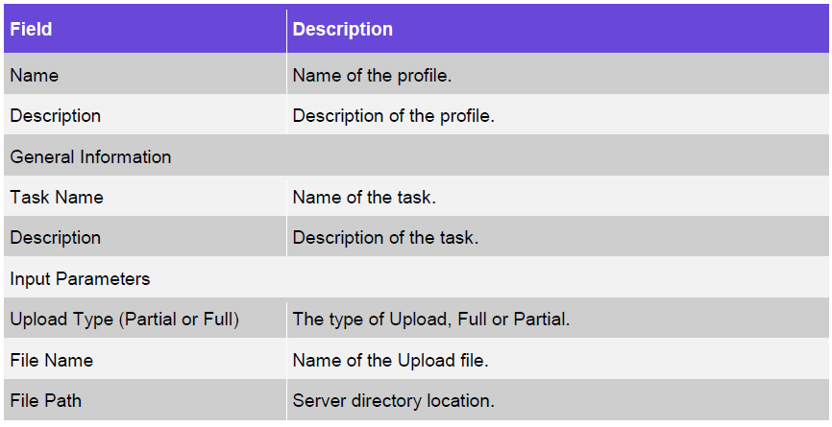
Target2 upload - overview
The TARGET2 directory lists the institutions that can be addressed in TARGET2. It contains Direct and Indirect participants’ BIC addresses. The Directory provides the routing information for TARGET2 payments and is organized alphabetically by institution.
System parameter
Task

Slide 10
SSI upload
SWIFTRef SSI data provides worldwide standing settlement instructions for retail and wholesale payments, ensuring a flawless straight-through payments process.
The SWIFTRef SSI directory contains three different types of files:
SSI plus – that contains SSIs for retail and wholesale payments
SSI Retail - SSIs for retail payments (commercial payments)
SSI Wholesale - SSIs for wholesale (FX, MM,Derivatives - cash payments)

Slide 11
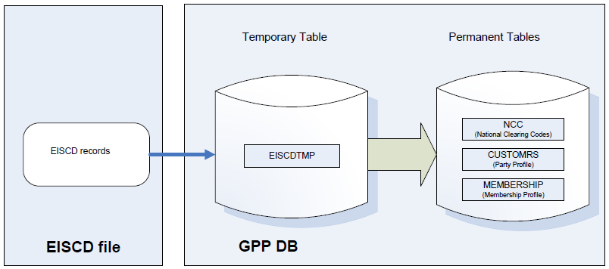
eiscd upload - overview
The EISCD upload task uses the data contained in the file to update the Financial Institution tables (NCC and CUSTOMRS) as well as Membership tables within GPP. Each branch or bank office in the EISCD file is identified by either Sorting code, or BIC and Sorting code.

Slide 12
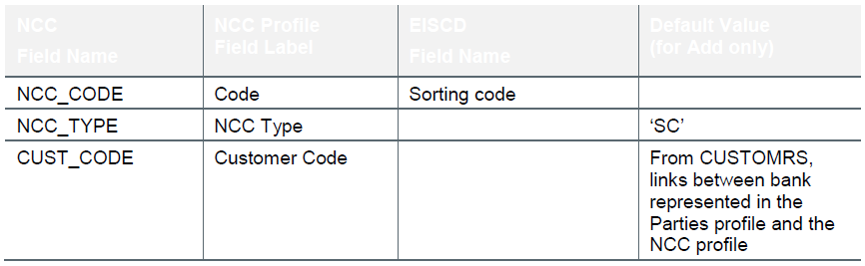
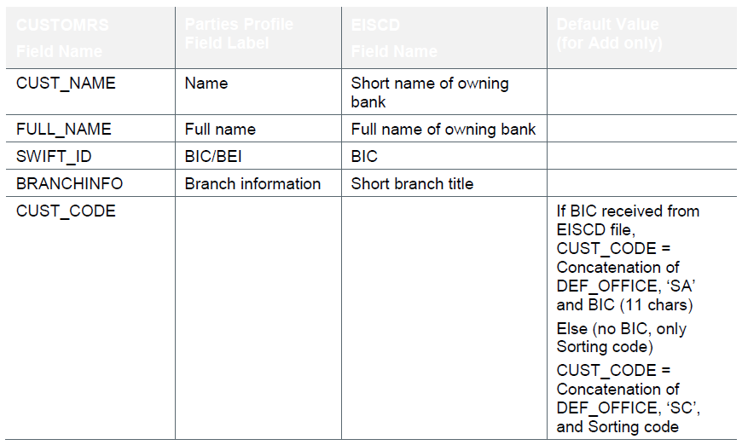
eiscd upload – customers & NCC
NCC
CUSTOMERS

Slide 13
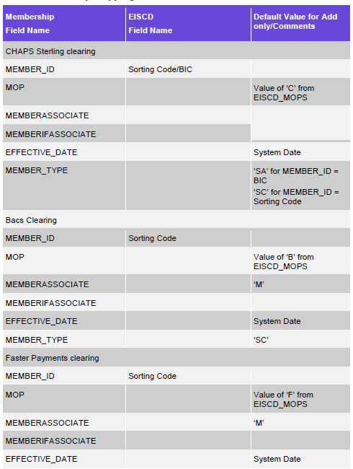
eiscd upload – membership
The system option EISCD_MOPS determines if any of the offices in GPP is a member of the clearing/clearings that can be uploaded from the EISCD file (Bacs, CHAPS Sterling and Faster Payments)

Slide 14
GPI upload – Overview
Gpi directory is used by financial institutions that use the data in the SWIFT gpi files to look up financial institutions' participation and reachability through domestic and international clearings and settlement systems within the scope of gpi. In addition, gpi directory is used to decide on payment routing options.
File Types
Daily full file - Published once a month. Only required for an optional data resynchronization.
Daily delta file - Published every day, including the weekends. Contains only the changes of the previous day.
Monthly full file / Monthly delta file - One delta file and one full file, published on the same day. Users can apply the delta files only, the full files only, or a mix of the two (but not in the same month).
Task name : SWIFT GPI Directory Upload

Slide 15
Static data services
This service (profileMultiActions - action) enables a third party application to perform different actions on a static data profile, such as Save, Hold, Delete and Activate. Applicable for Customers, Accounts, Calendar and etc… uploads
Enables multiple actions on multiple records in a single request. This service can be used for static data uploads. Supports all actions for this service using these values in the ProfileActionType (SV: Save ,HD: Hold, DL: Delete, AC: Activate, DC: Decline, AP: Approve )
Note: When working from several threads against several GPPs,
The sender thread must wait until a request is complete, meaning there is a successful SOAP response for the specific request before sending the ‘APPROVE’.
The processing duration of a request to change a profile is significantly longer compared to the processing duration of the APPROVE message. This means that when a request for change and an APPROVE for that profile are sent asynchronously, in most cases the handling of the APPROVE request will finish before the first request is done, and the record will stay in PENDING state.
Apply Changes is NOT relevant in this activity, as the UI displays the database status, and not the cache. This means that there is no need to send apply_changes after each request or approve, in order for the updates to the profiles to appear in the UI. Apply changes is only applied on the cache for processing purposes.

Slide 16
Static data services
<soap:Envelope xmlns:soap="http://www.w3.org/2003/05/soap-envelope" xmlns:prof="http://fundtech.com/SCL/ProfileActionsService" xmlns:stat="http://fundtech.com/SCL/StaticDataCommonTypes">
<soap:Header>
<q2:FndtHeader xmlns:q2="http://fundtech.com/SCL/CommonTypes">
<q2:credentials>
<q2:UserID>ADMIN6</q2:UserID>
<q2:Role>ADMIN</q2:Role>
</q2:credentials>
</q2:FndtHeader>
</soap:Header>
<soap:Body>
<prof:ProfileMultiActionsRequest>
<stat:header>
<stat:UserID>U_AUDIT</stat:UserID>
</stat:header>
<prof:profileID>459</prof:profileID>
<prof:effectiveDate>2010-11-17</prof:effectiveDate>
<prof:enableMaxAllowedErrors>true</prof:enableMaxAllowedErrors>
<prof:maxAllowedErrors>1</prof:maxAllowedErrors>
<prof:records>
<stat:record action="SV" >
<stat:field name="OFFICE" >US1</stat:field>
<stat:field name="DEPARTMENT" >PSV</stat:field>
<stat:field name="CUST_CODE" >ABCD</stat:field>
<stat:field name="COMPANY.BUS_REG_NO" >12345</stat:field>
</stat:record>
<stat:record action="HD" >
<stat:field name="OFFICE" >US1</stat:field>
<stat:field name="DEPARTMENT" >PSV</stat:field>
<stat:field name="CUST_CODE" >ABCD</stat:field>
<stat:field name="BUS_REG_NO" >12345</stat:field>
</stat:record>
</prof:records>
</prof:ProfileMultiActionsRequest>
</soap:Body>
</soap:Envelope>
This ProfileMultiActions request shows these actions:
Save: Indicated by SV in the action attribute of the record element. The request saves a new profile entry in the database with the specified values.
Hold: Indicated by HD in the action attribute of the record element. The request sets the specified profile entry with a HOLD status.
<ProfileMultiActionsResponse>
<returnCode>0</returnCode>
<description></description>
<errorsList>
<error>
<code></code>
<description></description>
</error>
</errorsList>
</ProfileMultiActionsResponse>

Slide 17
Thank you
Arnab Podder
Integration Team
Arnab.podder@finastra.com

